Slide 1
Foundations of Individual Giving: Identifying, Cultivating, and Stewarding Your Donors
BIB Volunteer Conference – June 2018
Kimberly Ward, Managing Director, First Coast Chapter BIB
Brent Glass, Associate Director, Individual Giving, BIB

Slide 2
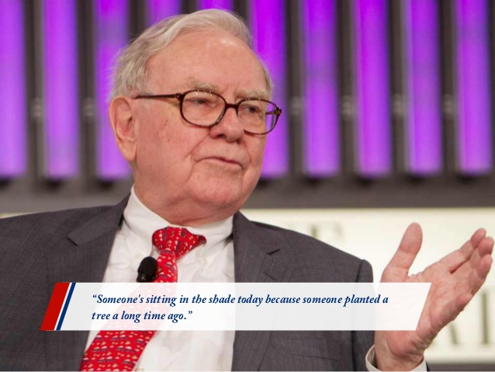
Foundations of Individual Giving

Slide 3
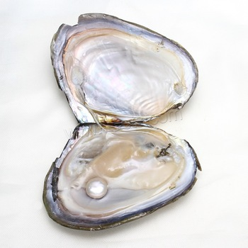
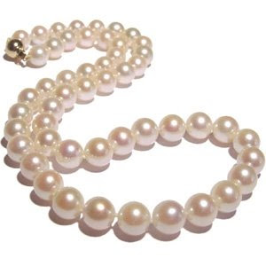
Foundations of Individual Giving

Slide 4
Foundations of Individual Giving
Stewardship – Expressing thanks for the gift
Identification – Friend-raising
Solicitation – Presenting a proposal/Making the ask
Cultivation – Building relationships

Slide 5
Foundations of Individual Giving
Identification
Special event attendees, weekly packing volunteer team members, civic & church group, event sponsors, current donors, donors to peer-to-peer campaigns
Cultivation
Dedicate time to build relationship
Invite to packing event, community event
Ask what area of BIB they are passionate about

Slide 6
Foundations of Individual Giving
3. Solicitation
Ask for support
Share Areas of Greatest needs: i.e. program growth, volunteers, community awareness
If No, ask why (area of need, timing, dollar amount)
Have next action clarified before end of meeting
4. Stewardship
Ask how they would like to be thanked and then thank them and thank them again
Show Outcome of Investment
Send updates, stories, kid thank you

Slide 7
Foundations of Individual Giving
Finding Donors in Special Events
Use your guest lists to find out how many times people have attended your special event. Discuss with event committee who needs follow-up.
Identify people who have purchased the high-end ticket, table, or sponsorship and cultivate them as potential donors.
So much money is left on the table because we do not follow-up with people who attend our events. An event without follow up = missed opportunity and money left on the table.

Slide 8
Foundations of Individual Giving
• Develop the attitude that you are aiding the individual and the decision making process by providing them with an opportunity to invest in a great, proven program where their money will be wisely spent.
• People give to people they know and trust. Build relationships first, and then ask.
• Keep potential and current donor informed of how well your program is performing and the successes.
•Remember your highest potential next donor is the one that just gave. Don’t be afraid to return to the same supporter at least twice per year. They already have invested in your program once and are twice as likely to invest again.

Slide 9
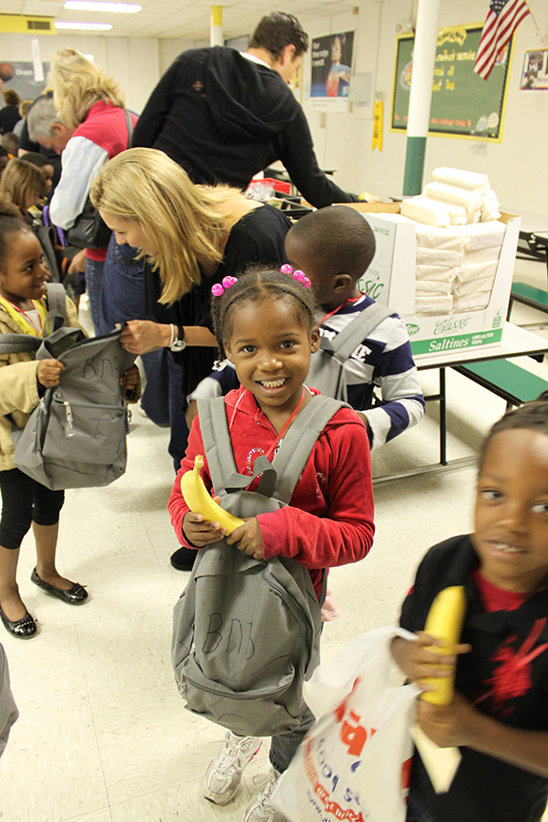
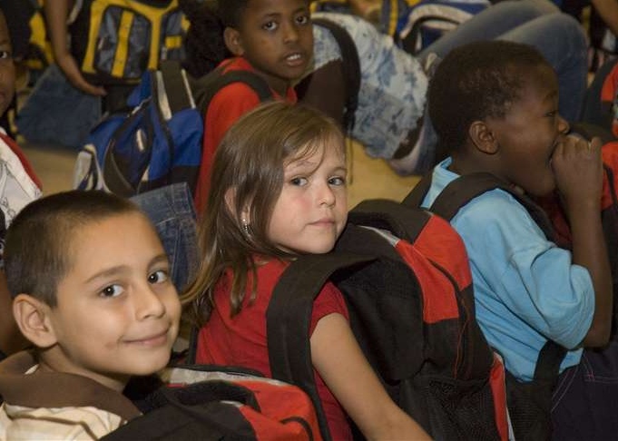
Tell Your Story

Slide 10
Foundations of Individual Giving
ACTIVITY : Prospect identification
List 5-10 names of special event attendees for your action plan.

Slide 11
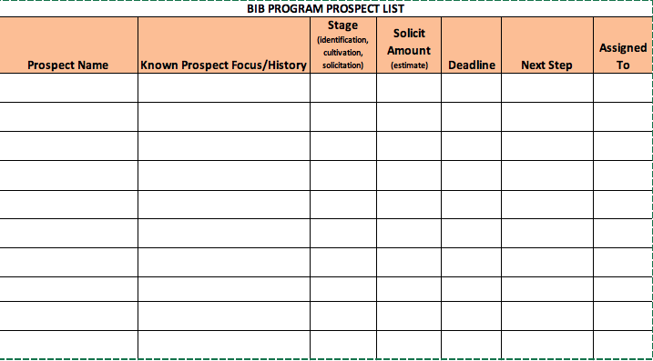
Foundations of Individual Giving

Slide 13
Foundations of Individual Giving
’AWE’ Moments
Questions?
Kimberly Ward 904-574-6802 Kimberly@blessingsinabackpack.org
Brent Glass 312-366-2749
Brent@blessingsinabackpack.org

