Slide 1
Across America This past school year, 13 million kids relied on their school's meal programs throughout the week for food.
But who helped feed them on the weekends?

Slide 2
YOU Did!
During the 2017-2018 school year, you helped Blessings in a Backpack (Blessings) provide more than 3 million hunger-free weekends for more than 87,000 kids nationwide.
With a bag of food in their backpacks as they left school on Friday, these kids had food to fill the 65-hour weekend nutrition gap.
Thank you for your generous support that helped make this possible.

Slide 3
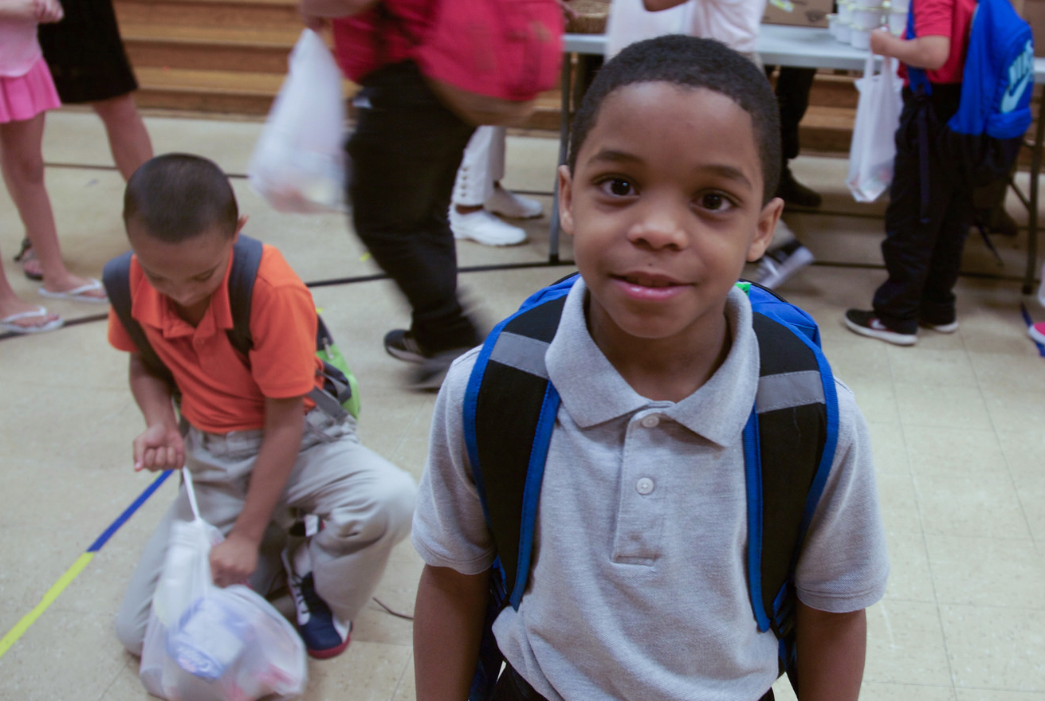
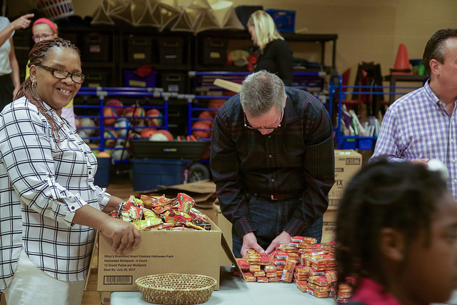
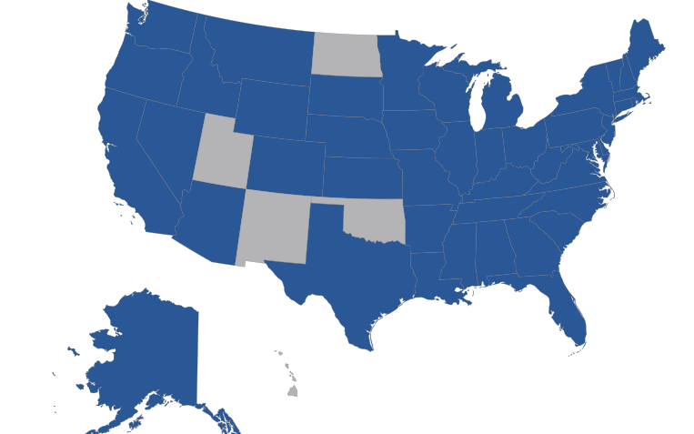
2017-2018 year,
By the numbers
87,300 kids fed every weekend
More than 3 million hunger-free weekends provided
More than 1,000 locations
Programs in 45 states and Washington D.C.
16,000+ volunteers nationwide

Slide 4
We asked the kids and their teachers to share with us the impact of Blessings hunger-free weekends, and the math is simple.
Kid + Food + backpack
=
Happy + healthy kids
78% of kids feel cared for by their community.
71% of kids feel that Blessings is helping their family.
60% of kids have fewer behavioral issues.
59% of kids find it easier to learn at school.

Slide 5
our Parents
say:
“Most people don’t think about how they are going to get food every day, but that’s what I worry about every day. So when this came along, I knew at least we would have something in our cupboard for this weekend.”
“It makes me very happy to get Blessings in a Backpack. One time my mom cried because she was happy that we had some food now.”
Our Kids
say:
OUR Principals
say:
“The love and generosity that this program has extended to our students, families, and faculty is astonishing.”

Slide 6
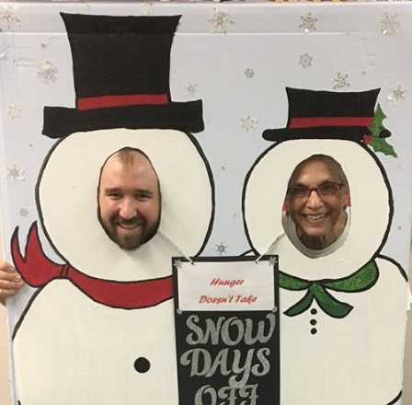
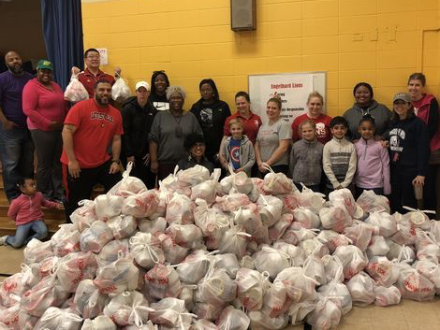
When school closes and hunger continues,
Blessings is There.
This past year, most Fridays followed the normal routine. But, from time to time, the unexpected happened – hurricanes hit multiple coastlines and snow storms dropped feet of snow, among other things. Many children left school, not knowing when they would next return or where they could find food without school in session.
Below are two stories of how Blessings stepped up when the unexpected happened. This impact is possible because of your commitment to feeding kids even during times of uncertainty. These efforts have inspired us, and we hope they will inspire you, too.
When snow fell leading into a weekend and school was closed the next day due to inclement weather, volunteers had over 2,000 “blizzard bags” ready to send home with children.
“Children shouldn’t have to worry about being hungry. They should be out playing in the snow.”
- Program coordinator

Slide 7
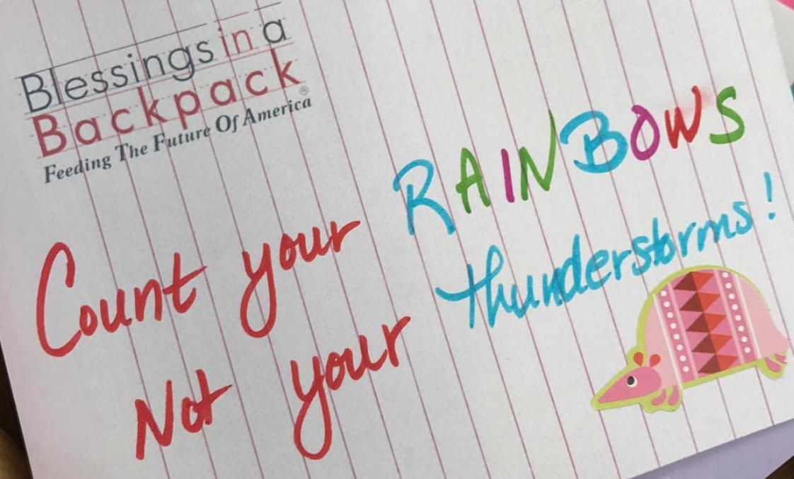
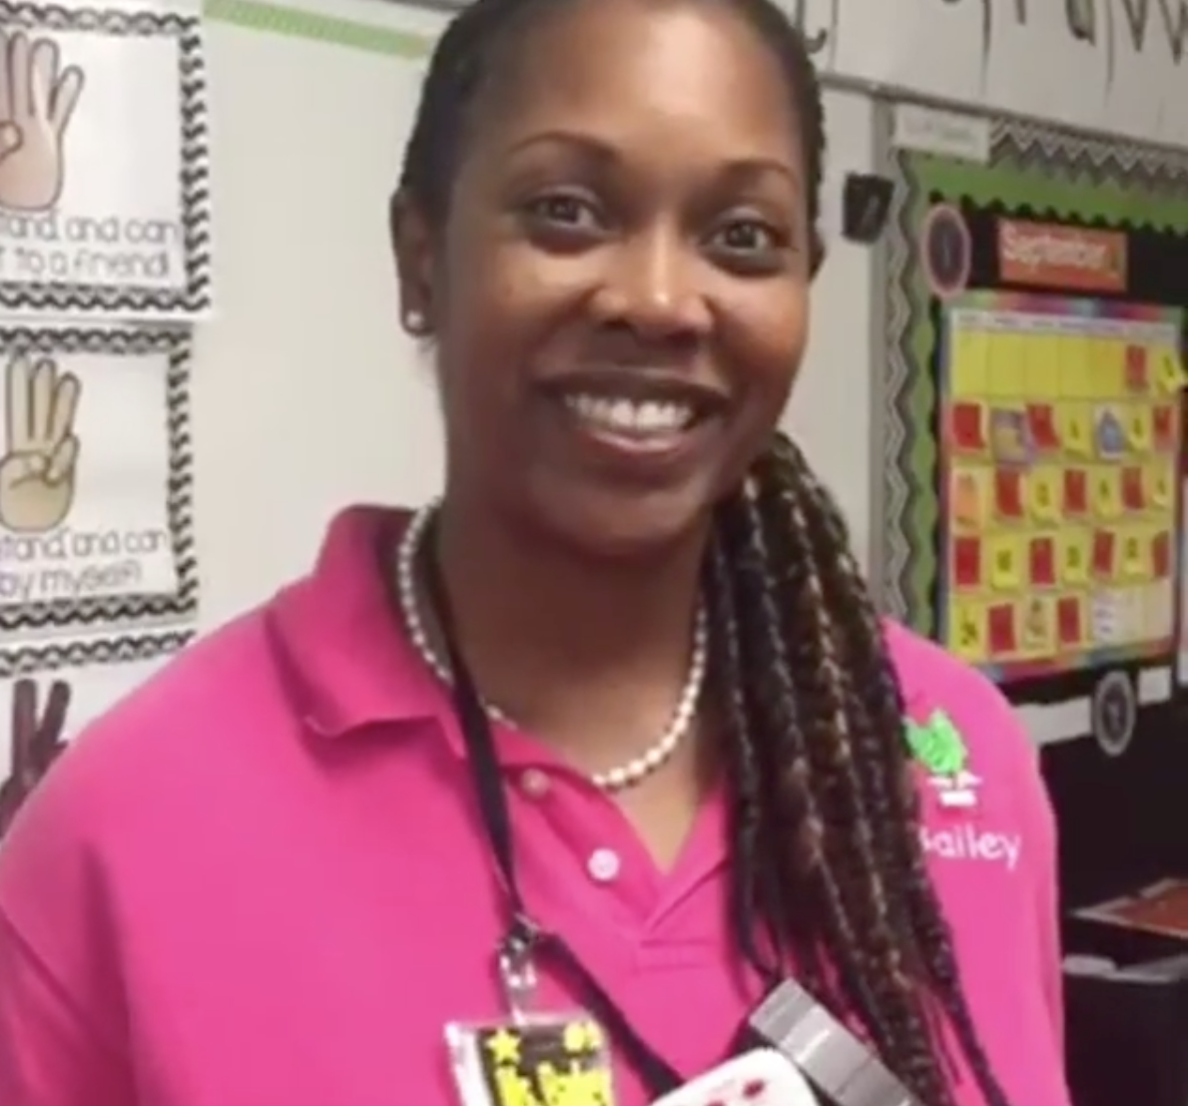
“Hurricanes are scary. And when you’re five or when you’re seven, and you’re already in a difficult situation, and something even more terrifying happens, you need someone to stand with you. You need someone to show up for you. It was such a blessing to go and visit my first-grade friends, to deliver their Blessings bag to them, and to meet that need, for them.”
– Ms. Bailey, teacher
When Hurricane Irma tore across Florida in September, many schools not in session for an extended period of time. At Hamilton Elementary School of Engineering and Technology in Sanford, Fl., teachers went above and beyond to ensure their students had food while school was closed. Teachers, such as Ms. Bailey pictured here, waded through knee-high water to flooded apartment complexes to distribute bags of food to students.

Slide 8
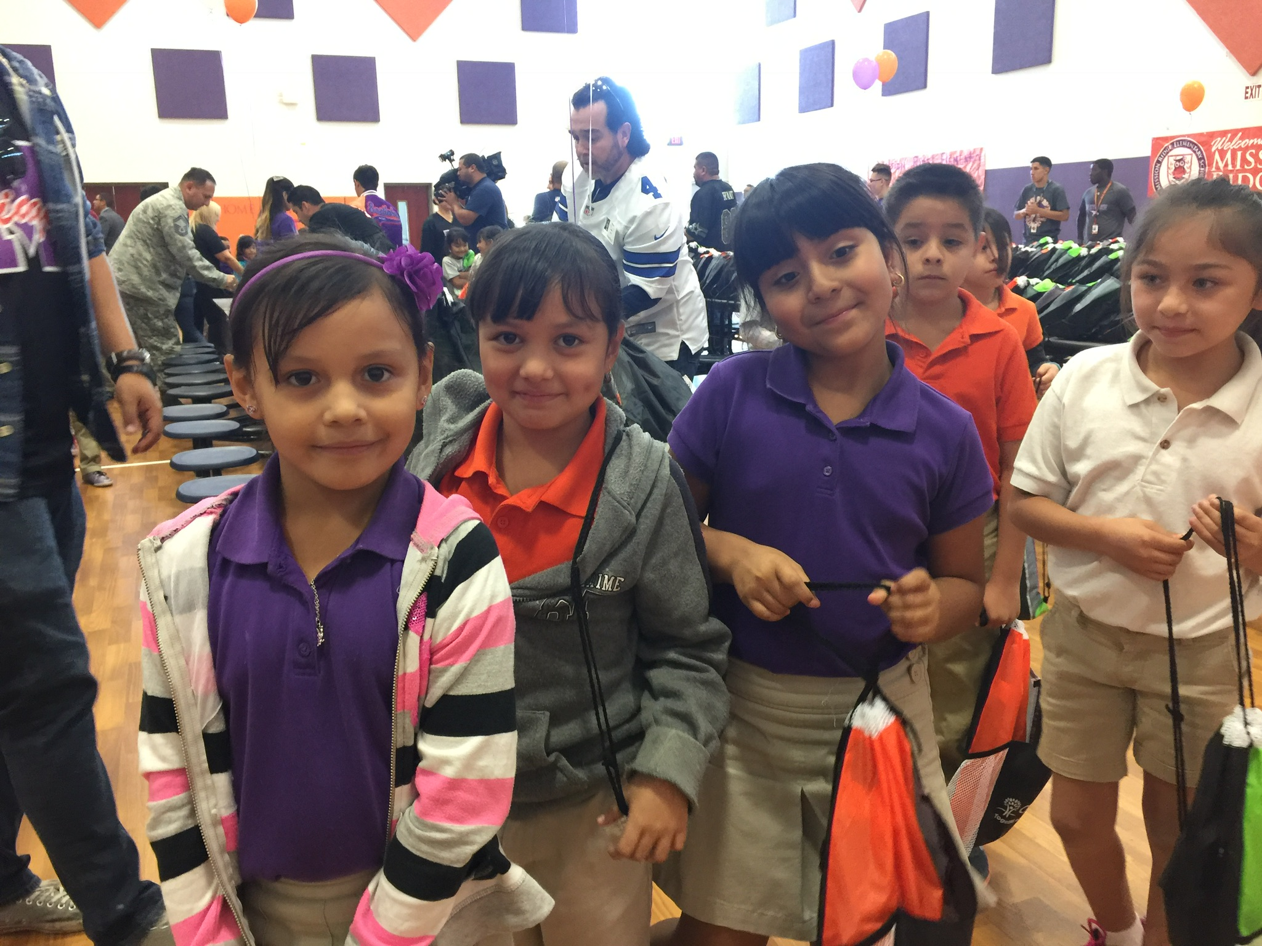
2017-2018:
Donor Name’s Impact
#,### kids fed every weekend
##,### hunger-free weekends provided
## locations
(or School Name)
## volunteers
(If no volunteers, add quote)
##,### pounds of food distributed

Slide 9
Awards and recognition
In April 2017, Blessings was awarded Charity Navigator’s four-star rating, the highest score possible, due to Blessings’ financial health, accountability, and transparency. The financial health score resulted from Charity Navigator’s analysis of Blessings in seven areas of financial efficiency and capabilities. Through this process, Charity Navigator recognized Blessings’ low overhead, and awarded Blessings a perfect score for the organization’s financial health. Blessings continues to focus on maintaining low expenses and using resources wisely to expand the organization’s mission and reach.
In addition to being awarded Charity Navigator’s highest ranking, Blessings is now a GuideStar Platinum organization, the highest level of recognition offered. As of April 2018, of the 49,000+ charities rated by GuideStar, only 8% were Platinum. This designation demonstrates that Blessings is focused on measuring progress and results, year after year.

Slide 10
This coming school year, Blessings will be celebrating its 10th birthday! The year-long celebration will include national and local events, campaigns, birthday parties, and preparing for the next 10 years. An invitation will arrive in your mailbox this summer!
Blessings has a new look! Please note our new logo and tagline on the left, and visit our website to see more!

Slide 11
Together, we made sure that when the school week ended, hunger-free weekends began. Thank you!
BlessingsinaBackpack.org

