Slide 2
One in six kids who relies on meals at school is without access to food at home on Saturday and Sunday.
Who will feed the kids this weekend?

Slide 3
Blessings in a Backpack
Our mission is to mobilize communities, individuals, and resources to provide food on the weekends for elementary school children across America who might otherwise go hungry.

Slide 4
Our History
Grassroots, volunteer-based organization
Founded in 2005 in Louisville, Ky.
501©3 incorporated in 2008
People Magazine‘s Charity of the Year in 2012
Charity Navigator 4-star rating
GuideStar Platinum participant

Slide 5
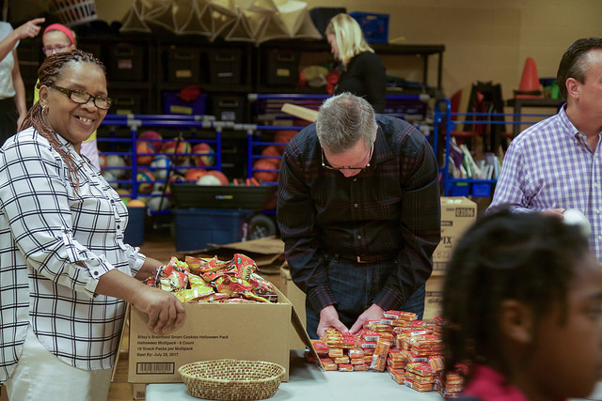
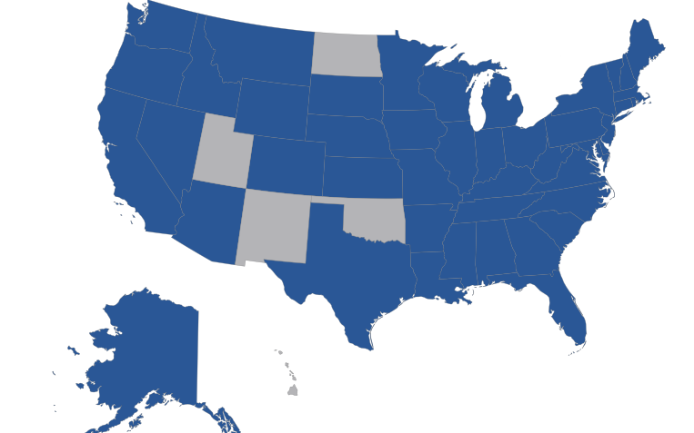
2017-2018 Year by the Numbers
87,300 kids fed on the weekends this school year
More than 3 million hunger-free weekends provided
More than 1,000 program sites across the country
We have programs in 45 states and Washington, D.C.
16,000 + volunteers nationwide

Slide 6
We asked the kids and their teachers to share with us the impact of taking home food on the weekends. And the math is simple.
Kid + Food + Backpack =
Happy, Healthy Kids
78% of kids feel cared for by their community.
71% of kids feel that Blessings in a Backpack is helping their family.
60% of kids have fewer behavioral issues.
59% of kids find it easier to learn at school.

Slide 7
The Ugly Truth About Childhood Hunger
Young people who grow up hungry are less likely to graduate high school. —National Commission on Hunger
Undernourisched children don’t learn as fast or as well as nourished children. —National Institute of Health
Children who struggle with hunger are sick more, recover slowly, and are hospitalized more frequently. —Children’s Health Watch
Lack of healthy food can impair a child’s performance in school. —Harvard School Breakfast Research Summary

Slide 8
#### of kids in COMMUNITY live in food insecure homes
Who will feed the kids this weekend?
Notes:
Add the number of kids your feeding and the name of your city/town

Slide 9
YOU WILL!
We need your support to make hunger-free weekends possible for the kids in COMMUNITY!
Notes:
Add the name of your city/town

Slide 10
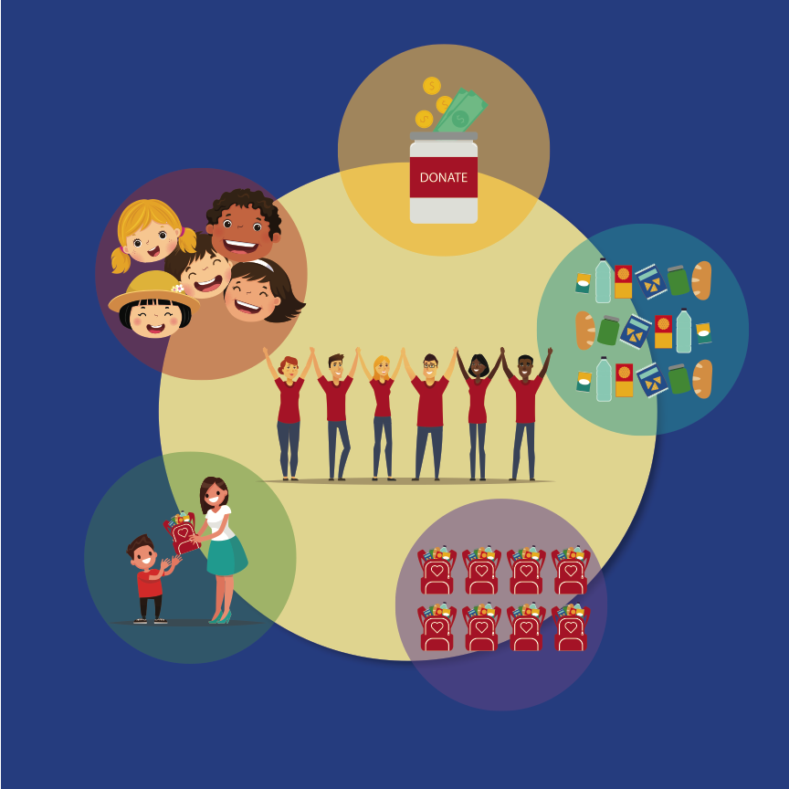
How it Works
Raise the resources
Secure the food
Pack the bags
Distribute the bags
Kids are healthy, happy, and ready to learn

Slide 11
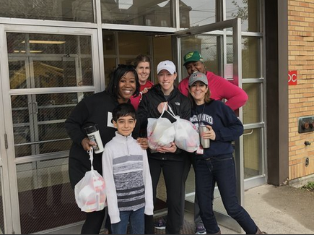
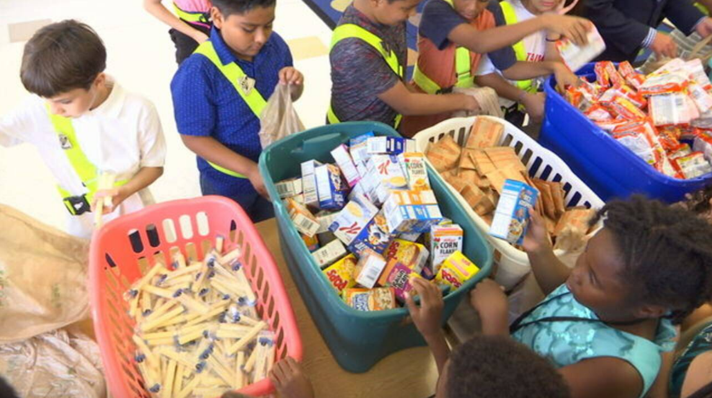
About Blessings in a Backpack PROGRAM NAME
XXX kids in COMMUNITY fed on the weekends this school year
We send kids home on Fridays with backpacks full of nutritional food
We provided more than XXX hunger-free weekends last year
It costs $XXX to feed a child every weekend this school year
LIST SCHOOL NAME(S)
Notes:
Update this page to represent the numbers and impact of your program.

Slide 12
Partnership Opportunities
Support the kids in our community
Cause marketing promotions
Sponsorships
Employee volunteerism with packing events
Celebrate Blessings in a Backpack’s 10th birthday
And more!
EDIT TO MEET YOUR NEEDS
Notes:
Add your partnership opportunties

Slide 13
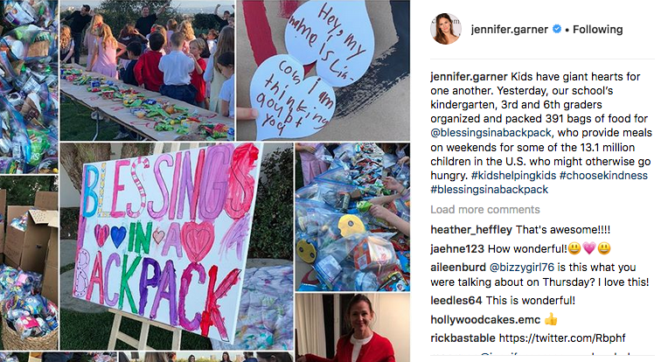
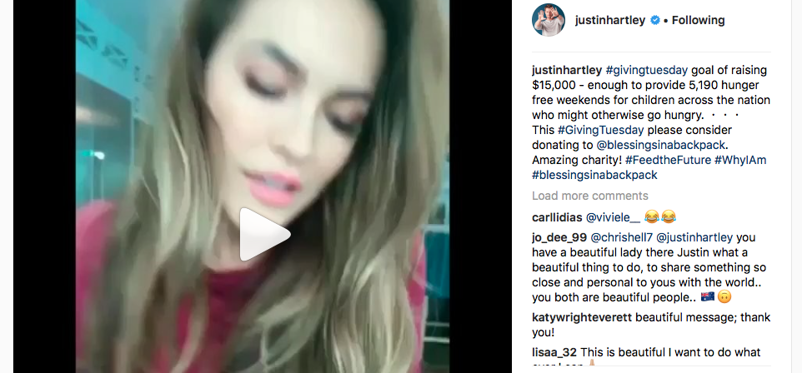
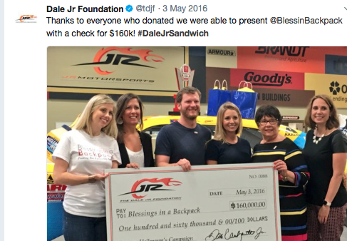
Raising Awareness
More than 35,000 people follow us on social media
More than 23,000 e-news subscribers
Average open rate is 24 percent — above industry standards
472,400 page views* on our website
Celebrity supporters include Jennifer Garner, Justin and Chrishell Hartley, Justin Rose, Dale Earnhardt Jr., and Evan Turner
* During Fiscal Year 17

Slide 14
Use this slide to talk about your program’s social media reach and engagement, if applicable
Delete this slide if not needed.

Slide 15
Our Supporters Are . . .
Predominantly female
40’s/GenX to middle and high school students
Purchasing decision makers
Health conscious & nutrition savvy
Brand savvy
Expendable income
Super shopper
Active on two + social networks
Highly influential

Slide 16
You Will Be In Good Company

Slide 17
Use this slide to list the logos of your program’s corporate and celebrity partners
Delete this slide if not needed.

Slide 18
"I appreciate being able to work with a reliable partner who delivers a great product and makes a difference for our communities across the country.” —Tiffany Etter, Foundation and Social Responsibility, Anthem
Our Partners Say:
“It makes me very happy to get Blessings in a Backpack. One time my mom cried because she was happy that we had some food now.”
The Kids Say:
The Principals Say:
“The love and generosity that this program has extended to our students, families, and faculty is astonishing.”

Slide 19
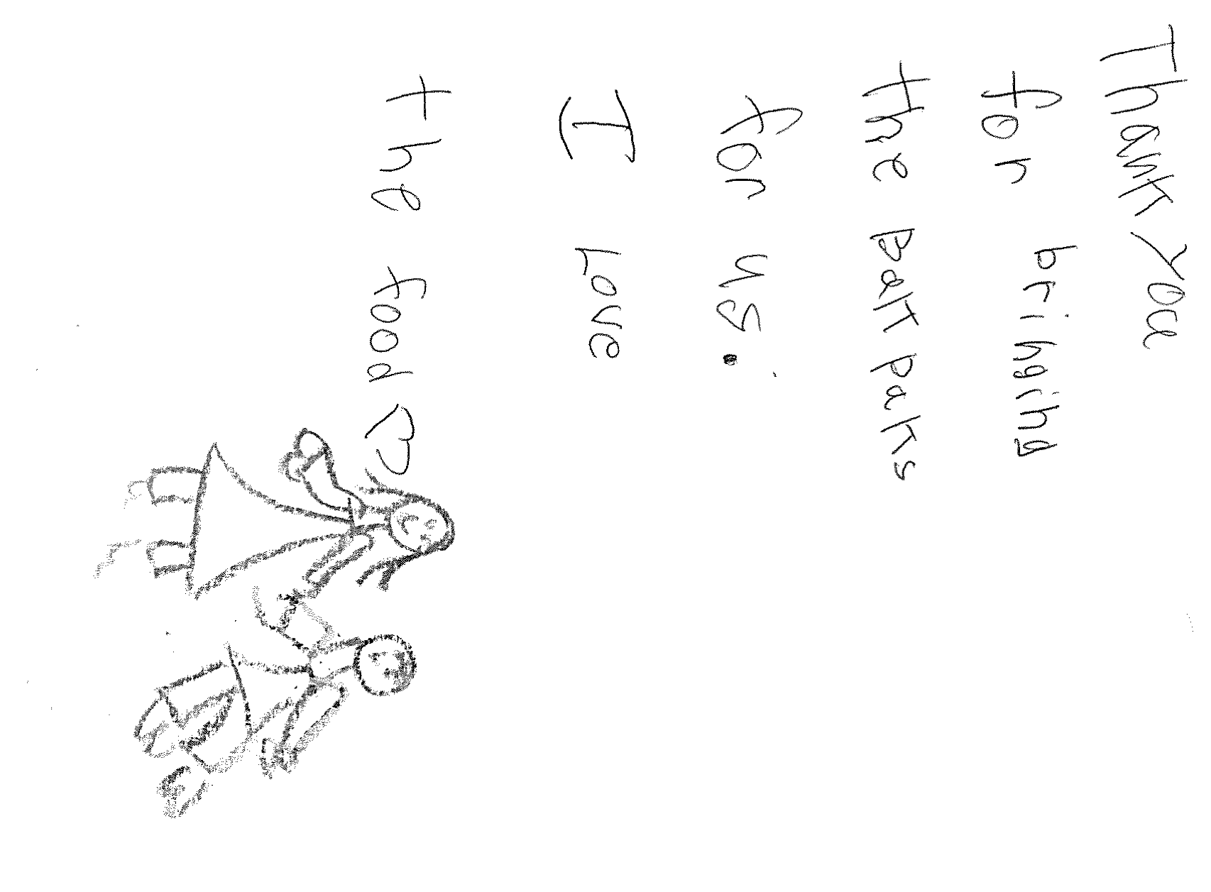
Who will feed the kids this weekend?
We hope you will!
Contact:
PROGRAM COORDINATOR NAME
Volunteer Program Coordinator
Blessings in a Backpack PROGRAM NAME
EMAIL@EMAIL (XXX) XXX-XXXX
blessingsinbackpack.org

