Slide 1
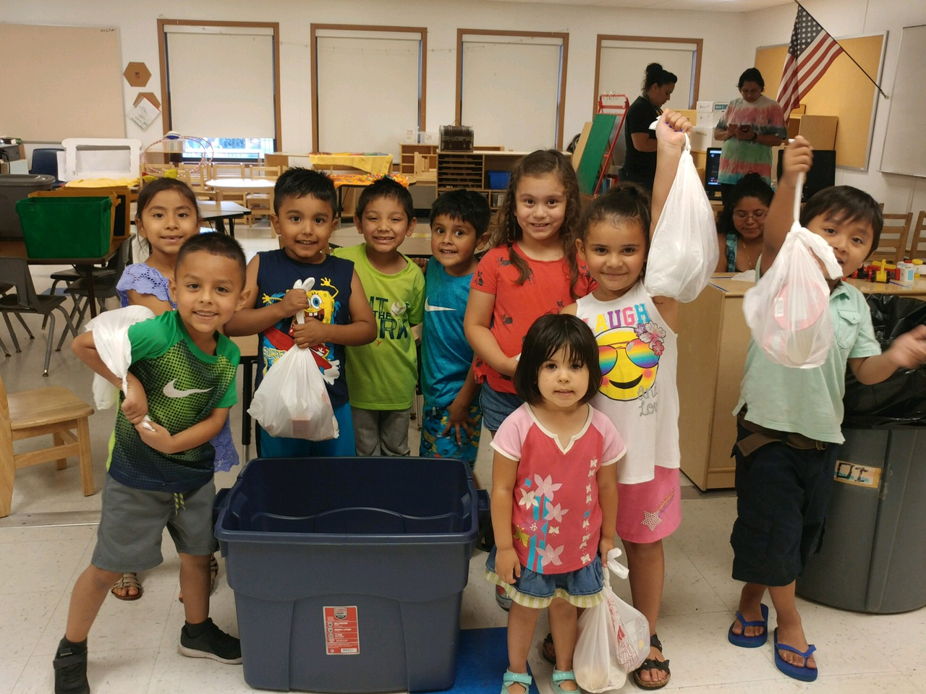
Region/sTATE NAME
Blessings in a Backpack is proud to have provided Kid# students with HFW# hunger-free weekends in the REGION as a result of your generous contribution.
As mentioned before, the best evaluation of Blessings comes from those involved, and in particular those receiving the weekend nutrition.
“It makes me very happy to get Blessings in a Backpack. One time my mom cried because she was happy that we had some food now.”
—Blessings student

Slide 2
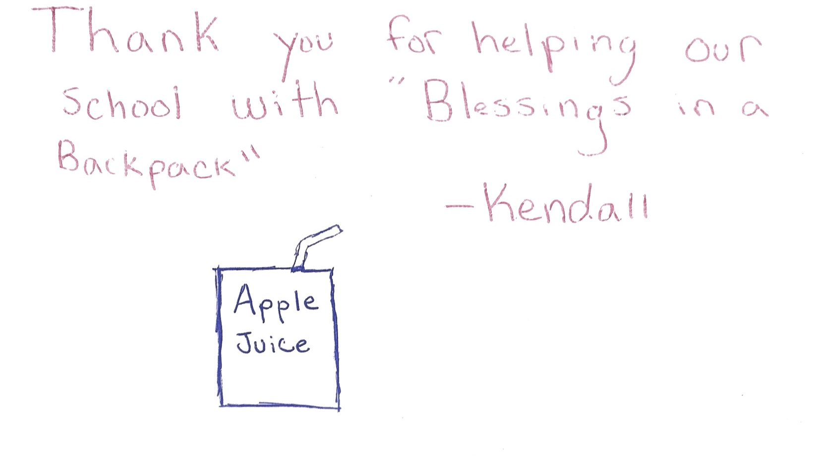
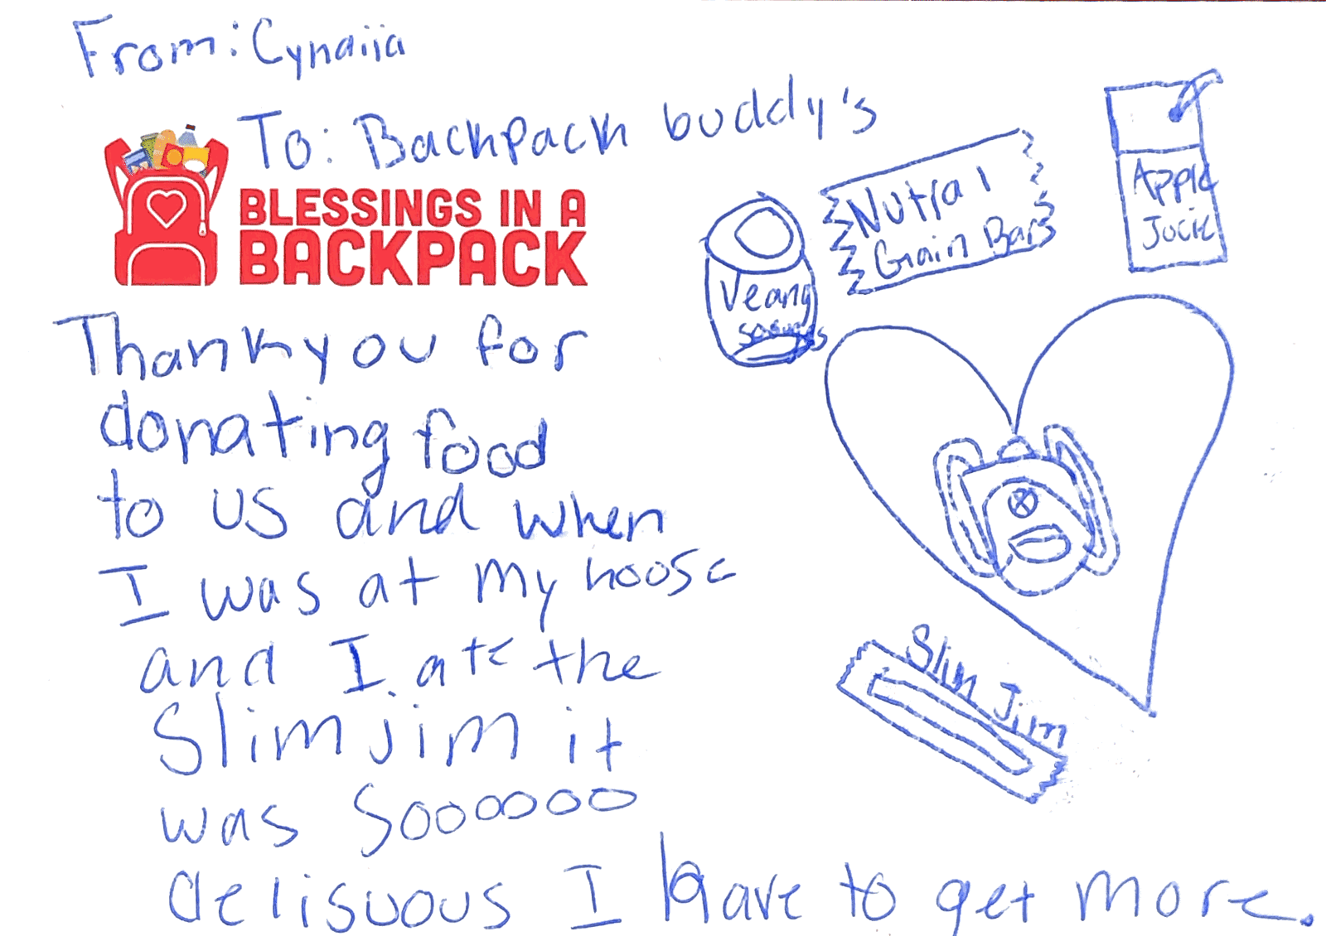
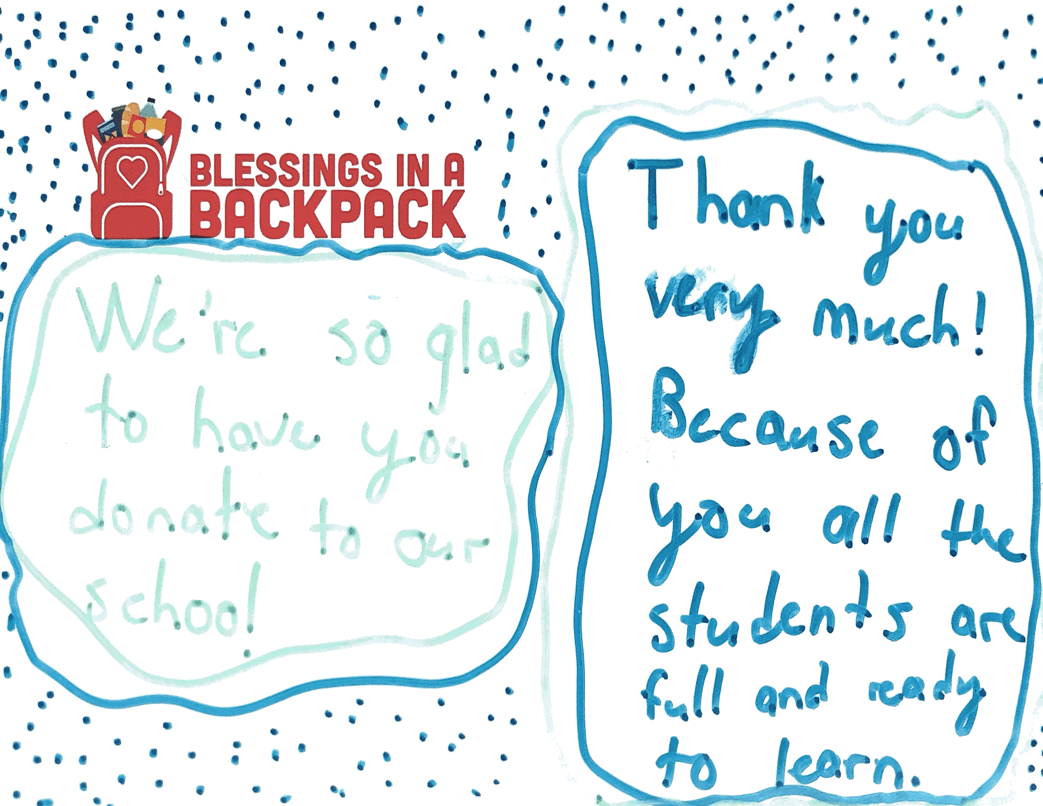
Name
Title
Email
Phone #

